Slide 1
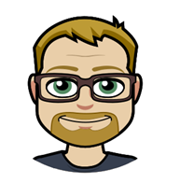
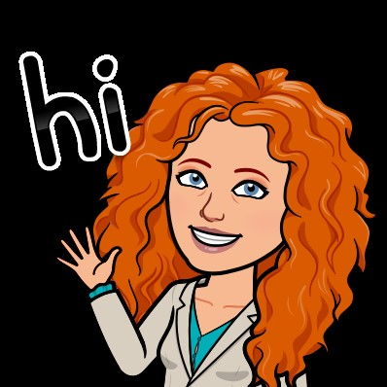
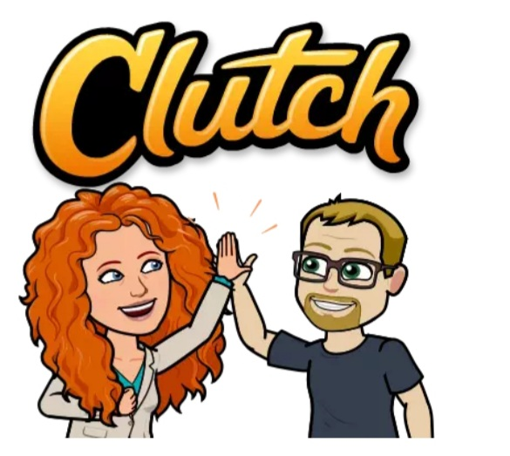
About Us
Jim
* Has worked in IT forever (since 87)
* Navy vet – submariner
* Has a sweet Bourbon collection
Amanda
* Not techy, but talky
* Disney nut
* Wine fan
Team Jimanda
* Agile enthusiasts
* Happy Hour buddies
* Friends despite Packers/Bears rivalry
Notes:
Jim:
Amanda: My name is Amanda Palovcsik, and I'm a Senior IT Manager in our Lending IT department, focused on agile delivery. I consider myself less of an 'IT' person, but I'm not afraid to jump into a conversation on most topics! I've never been a developer, but it doesn't stop me from trying to talk the language! I am a self proclaimed Disney nut, though most of my friends would agree without question on that one! I travel there at least once a year, but in reality it's more like 2-3 times per year. I'm also a wine fan, and think a glass of cabernet is one of the most relaxing ways to end an evening!
Jim and I have known each other for the better part of 7 years, having met at CUNA Mutual Group! We started working together on some of the first agile projects in our company, and through that time finding a lot of common ground over agile topics, and our love of happy hours! COVID may have slowed us down, but hasn't stopped us! And despite a bitter Packers/Bears rivalry, we maintain our friendship through football season, mostly because Jim is so good natured about all the joking I do about the Bears!

Slide 2
‘Just one great partnership with the right person can have an incredible impact on your business success.’
- Janine Ogg and Jo Foster
‘Teamwork is the ability to work together toward a common vision. The ability to direct individual accomplishments toward organization objectives. It is the fuel that allows common people to attain uncommon results.’
- Andrew Carnegie
Notes:
Jim

Slide 3
Company/Team Background
CUNA’s agile journey
Provides financial services to cooperatives, credit unions, their members, and other customers worldwide; sells commercial and consumer insurance and protection products.
Roughly 3,700 employees located in Madison, Waverly, Fort Worth, and abroad, headquartered in Madison, Wisconsin
Working with agile for roughly 6 years, a mix of SAFe, LeSS, scrum, Kanban, Extreme Programming, Lean Six Sigma
Started in IT, and have expanded with our business partners and PMO
Constantly learning and adapting, sharing lessons across different CoPs
Notes:
CUNA Mutual group was founded more than 80 years ago by credit union leaders. CUNA helps credit unions, businesses and individuals build financial security through a variety of commercial and consumer insurance and protection products. This year has been no exception to challenges and opportunities for us to serve our customer base and provide more support than ever!
We have just under 4000 employees located throughout the United States and Carribbean, and our headquarters are in Madison, Wisconsin.
CUNA has implemented a variety of project management approaches, and our agile journey started about 6 years ago. We have many departments at CUNA, and have worked with a mix of agile approaches, including SAFe, LeSS, scrum, Kanban, Extreme Programming, and Lean Six Sigma. Like many organizations, our agile journey started in IT, and has moved into partnership with our business teams and the project management office. We have Scrum Masters, Technology Analysts, Business Analysts, Product Owners, developers, tech leads and transformation leads helping with this journey in different projects and teams throughout the company. It's quite a mix, and we're constantly learning and adapting to what works, what doesn't, and recognizing the differences between teams that makes each of them a unique opportunity to find the right fit of agile. We also have a large Community of Practice for each of these roles, helping learn from others, and expanding our agile footprint within the company.

Slide 4
Company/Team Background
Digital Lending approach
STOP
creating standalone, proprietary, end-to-end solutions that require potential customers and partners to use our tools
START
providing a way for customers to purchase our insurance products in our partners existing digital channels, using APIs
We have become a technology enabler for our customers
Traditional Business and IT lines were blurred
Our old way of doing business was too slow and too costly
Notes:
Jim

Slide 5
We had challenges to address:
Even simple changes cost a lot
Business wanted to get everything done at once
Trust was gone
Lack of flexibility once initial requirements collected
Business/IT goals were not always aligned
Notes:
So we’ve identified what we’d like to implement in that Digital Lending space, but as you are likely all aware by attending this session, we had some challenges to overcome. I’m sure these are a similar mix to what you may have experienced, or are still facing.
Making changes was not easy – because project run long, sometimes over budget, and may no longer be exactly what was needed at the start, both business and IT recognized simple changes cost a lot. For those in IT, we know what seems simple may be a challenge to code. And for our business partners, ‘why can’t we make that button green instead of blue? Seems simple!’ But due to the cost, time and resources put into work, often those changes came with a high price tag. And let’s face it, by the time something was released, we were often on to the next project.
Which is a great sequi to the next point – Business wanted to get everything done at once! How many folks here run into a project being so large, it was going to be years to get something of value out the door? (sheepishly raises hand) Our business recognized that if it didn’t get done in the first place, it wouldn’t get done at all. Cost was too high, and projects are so large that small changes wouldn’t happen. So it was a huge dump of requirements from the start that the projects were lengthy and costly.
To add to it, there was no trust. Business didn’t trust IT would get everything they wanted done, as they wanted it, and IT didn’t trust the business was asking only for what was needed. The fingers would point at each other as to why things were failing, and it wasn’t healthy.
As is with many waterfall projects, we collected requirements up front. Once we’d ‘locked those in’ and started development, there was little to no opportunity to change them. So we’d continue through a project with requirements we knew needed to change, without an ability to do so without severely impacting our timeline and budget.
And finally, our business and IT goals were not always aligned. Our business partners wanted the latest and greatest, and our IT team just wanted to get off a system that was no longer being supported. While IT was always striving for delivering what the business wanted, it was a challenge with increasing technical debt.
But we knew we needed to make a change to make this a more positive, productive experience for everyone.

Slide 6
‘It is amazing what you can accomplish if you do not care who gets the credit.’
- Harry S. Truman
Notes:
Jim – transition
none of this is earth shattering or new. Frankly, its how you manage most non work relationships in your life

Slide 7
We needed to change
One Team
Co-located in a project room.
Business is IT’s partner, not their customer.
Business weighs in on IT decisions, and vice versa.
All work is aligned to business goals (OKRs).
Build trust by supporting each other's causes.
Eliminate blame.
Requirements Management
The team defines work, not the business. Everyone’s input is critical.
Don’t ask questions to business that they can’t answer.
Don’t ask the business about options that are not available.
Share the impact of a decision when asking for one, not after.
If a requirement significantly changes effort, provide other options.
Notes:
Jim

Slide 8
When the ship started to turn
Business and IT compromise to support each other
Having good and willing partners is key!
Business understands the technical needs and benefits.
IT understands, and helps drive, business value and priority.
It was no longer a push/pull of who got what, but true collaboration of value to the team and organization
Couldn’t have done this if we weren’t using agile. Waterfall creates and reinforces division. Everyone is in CYA mode in Waterfall
Notes:
Amanda:
So our business and IT team agreed together these were good changes, and agreed to compromise to support each other. It was no longer about business getting what they wanted, or IT getting what they wanted, but truly understanding and supporting what was best for the company. Sometimes this was an IT upgrade, and other times it was new business functionality. The compromise is possible because of open communication and understanding. And because both areas felt that security, they became champions of each others’ priority. One exciting outcome and benefit to everyone involved is that as a result of this open communication and transparency, both the IT Tech Lead and Business Owner could ask the other to step in for them in any conversation. Technical and business knowledge was openly shared and supported. Five years ago we never would have thought the Tech Lead would step in to a business conversation and drive their priority, but it now happens!
Jim – last 2-3
Emphasize the agile influence

Slide 9
Improved results
Stronger IT and business relationship
Built trust, collaboration, less tension
Empowerment to the team
Learned better practices that led to better outcomes
Team witnesses and is a recipient of good nature
Encouraged to make decisions and work with their product owner
Quicker results
Aligning business and IT has eliminated a lot of back and forth
Allowed the team to focus on what was relevant, important, and the best use of funds
Notes:
Amanda
Like we mentioned before, this collaboration, trust and partnership had far reaching effects. First and foremost, it created a stronger relationship between business and IT. There was no longer a tug of war between priorities, a concern work wouldn’t get done, or a concern of disappointing a customer with unmet expectations. The open communication, no finger pointing, and clear expectation setting are not crazy new concepts. But they are hard to stick to when there are different expectations from different areas. But holding firm to these just helps pave the way for ongoing trust and collaboration.
Jim 2 and 3

Slide 10
Like any good relationship, it takes work
‘A business partnership is like a marriage, at times you’re going to have conflict. We found a way to work together that worked out through this whole situation.’
- Peter Feinstein

